Slide 1
ADOBE
ANALYTICS

Slide 2




PROCESS
PROBLEM
ADOBE ANALYTICS
SOLUTION/RECOMMENDATION

Slide 3
Problem statement

Slide 4
#1
We wanted to observe some differentiating digital behaviors among guests that book through Hilton owned digital channels and online travel agents (OTAs). With that, we also wanted to find any opportunistic moments within the digital booking flow where Hilton could intervene to encourage direct bookings before a guests goes to an OTA.

Slide 5




DIRECT CHANNELS
OTA (OTHER TRAVEL AGENTS)
RES CHANNEL

Slide 6
difference in user behavior: OTA vs Websites

Slide 7
Difference in User Behavior: OTA vs Websites
We assume that there might be a difference in OTA and Direct bookings which might be due to various reasons :
1. OTA delivers more visibility and reach.
2. Direct bookings help with better guest relationships.
3. Direct booking saves revenue shares.
4. OTAs deliver an efficient experience.
5. Direct Booking provides access to loyalty programs.

Slide 8
Difference in User Behavior: OTA vs Websites
Considering the major factors and all of these reasons, we see that Direct bookings have seen an increase as compared to the OTAs. This is because:
1. OTAs have lately increased their commissions, cutting into hotels’ profits.
2. OTAs focus more on business rather than providing an experience, and this might not help hotels build strong guest relationships through OTAs.
3. The increasing number of online travel agencies give people dozens of confusing booking sources and sometimes offer irrelevant products that may not be worth it for target customers.
4. By using a direct booking system, it is easier for hotels to make use of guest data available to enhance guest experience levels for every visitor.

Slide 9
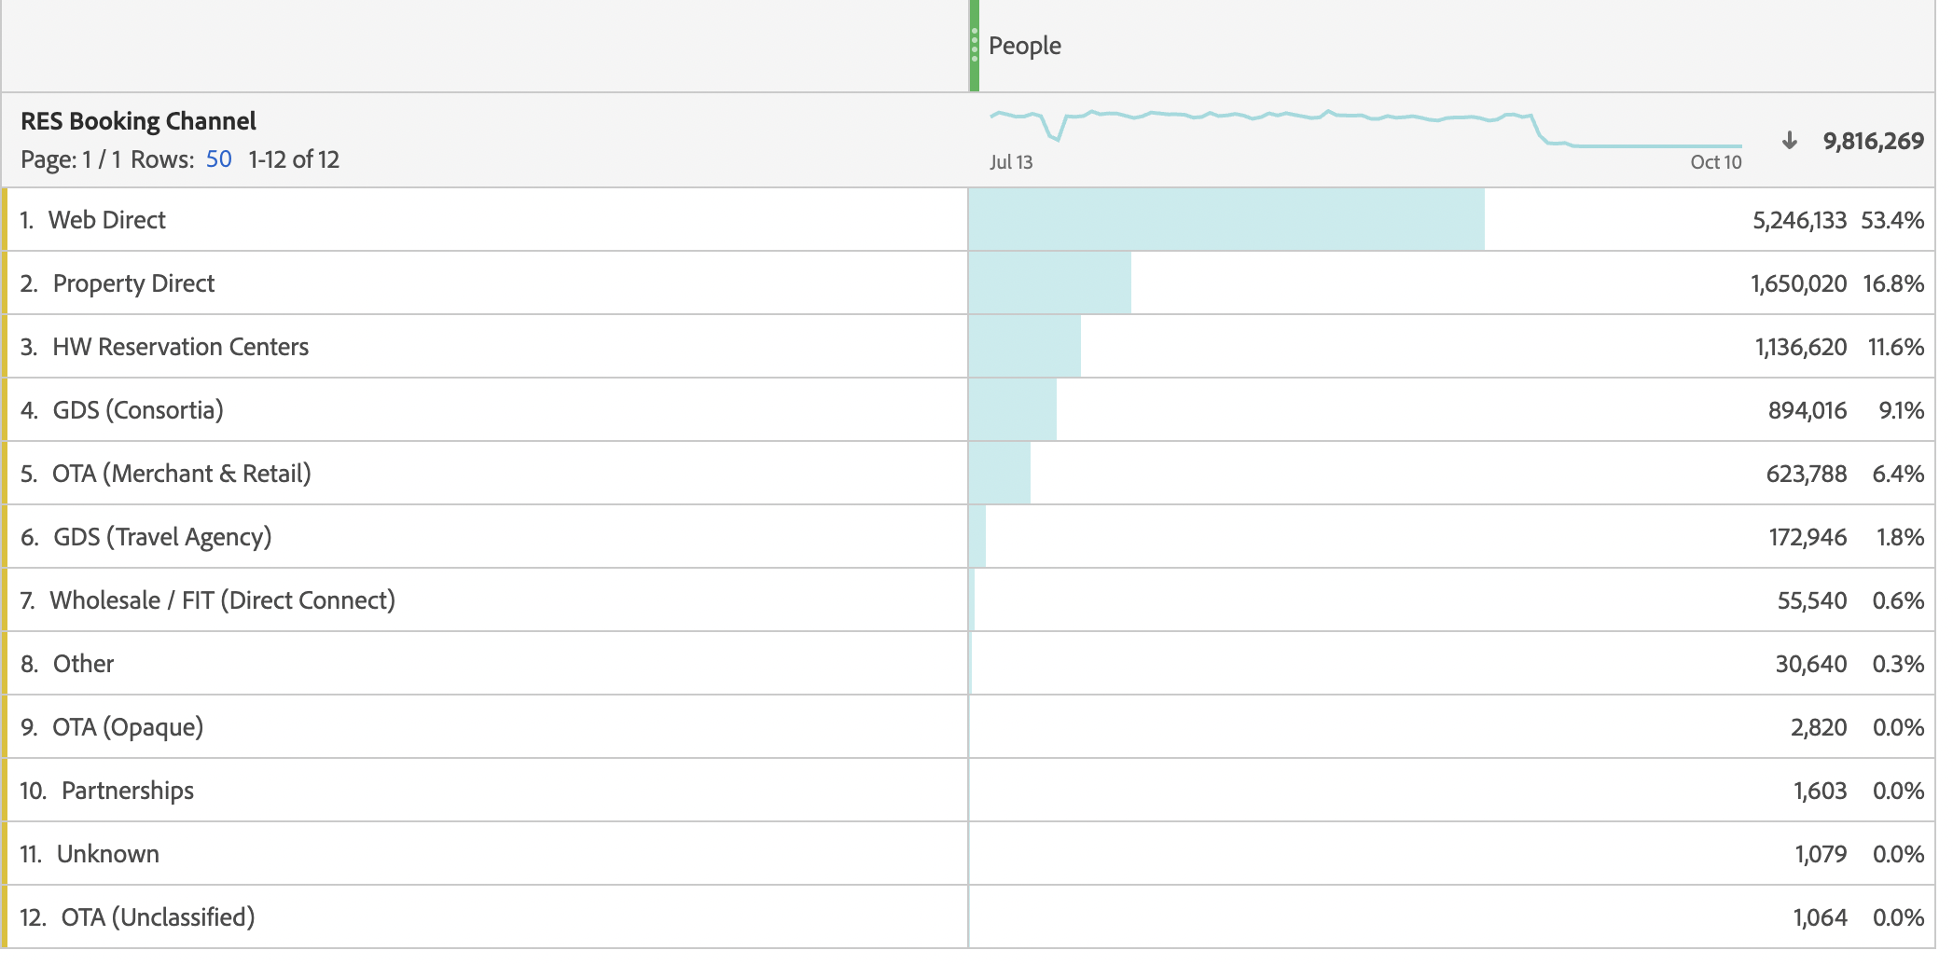
Hilton has managed very well to possibly leverage a few of the mentioned points, and that is why we can see a significant difference in the traffic between Direct segment and the OTAs.

Slide 10
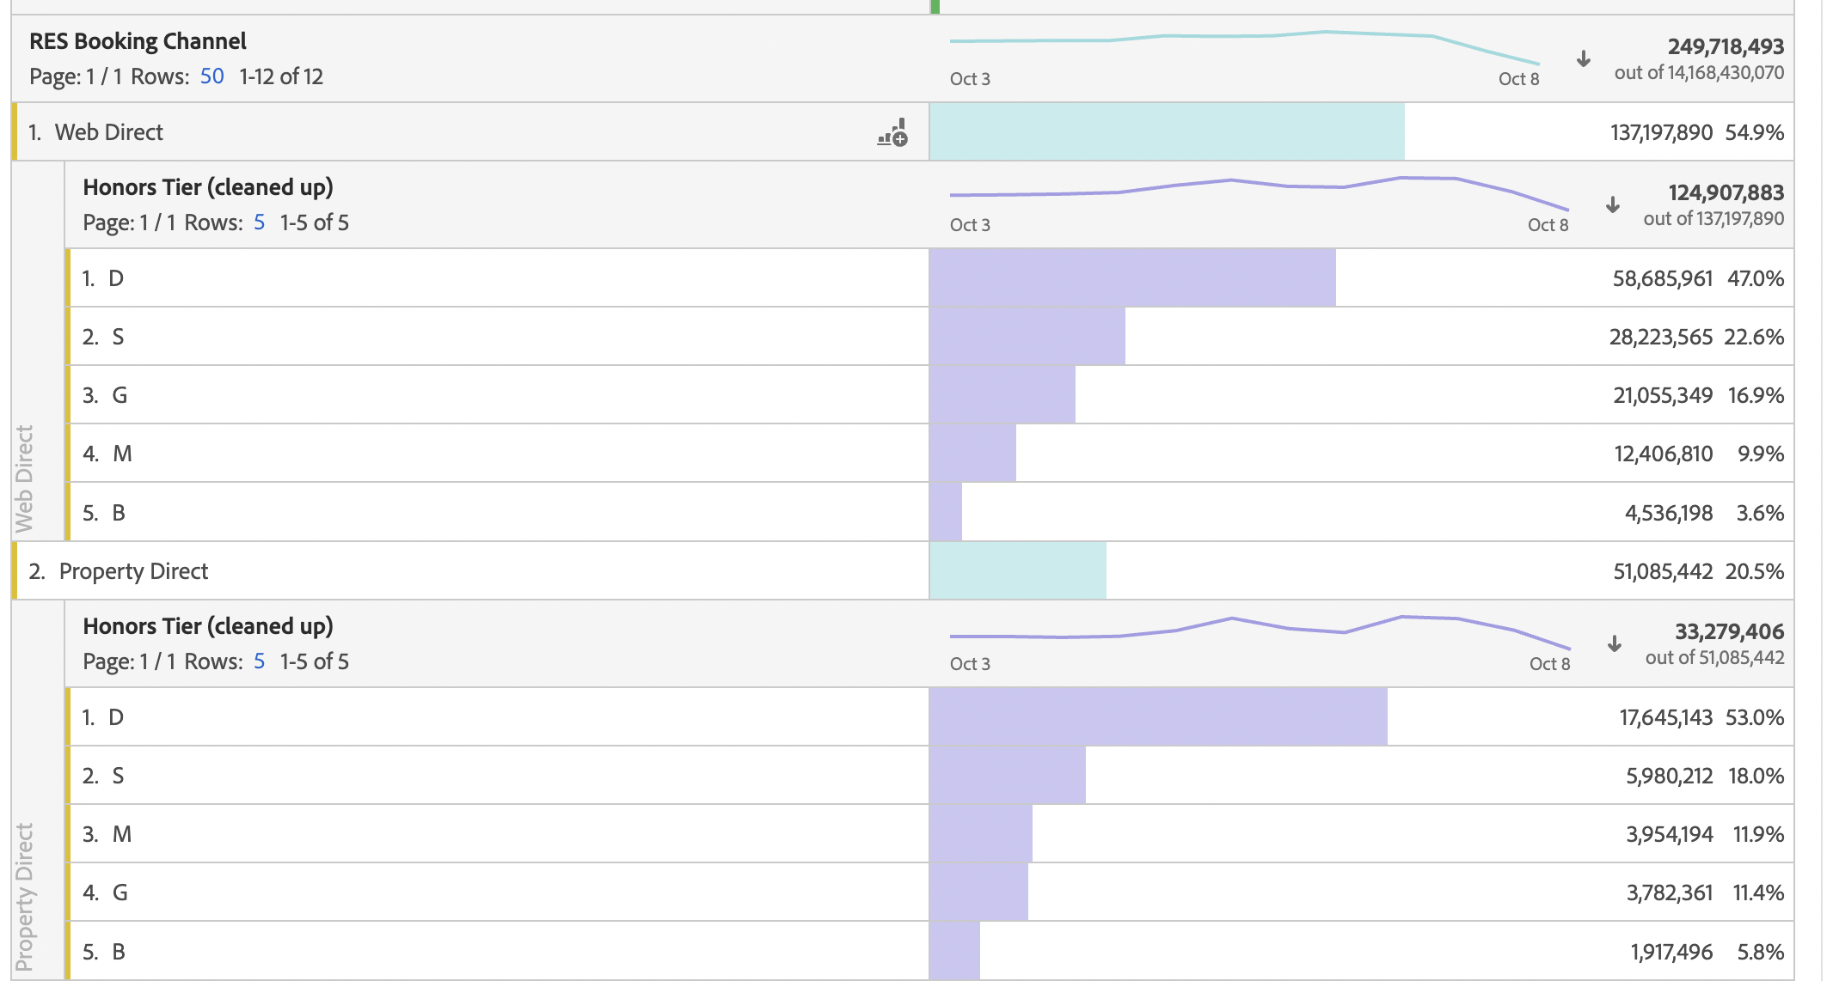
Out of all the membership types, Blue (or Member), Silver, Gold, and Diamond, we see that the Diamond members (represented by D) have the highest share on the Direct channels.
This shows us that Hilton is able to cater to the needs of its premium customers, and is able to provide an enriching experience, which could be learning for many industries across different verticals.

Slide 11
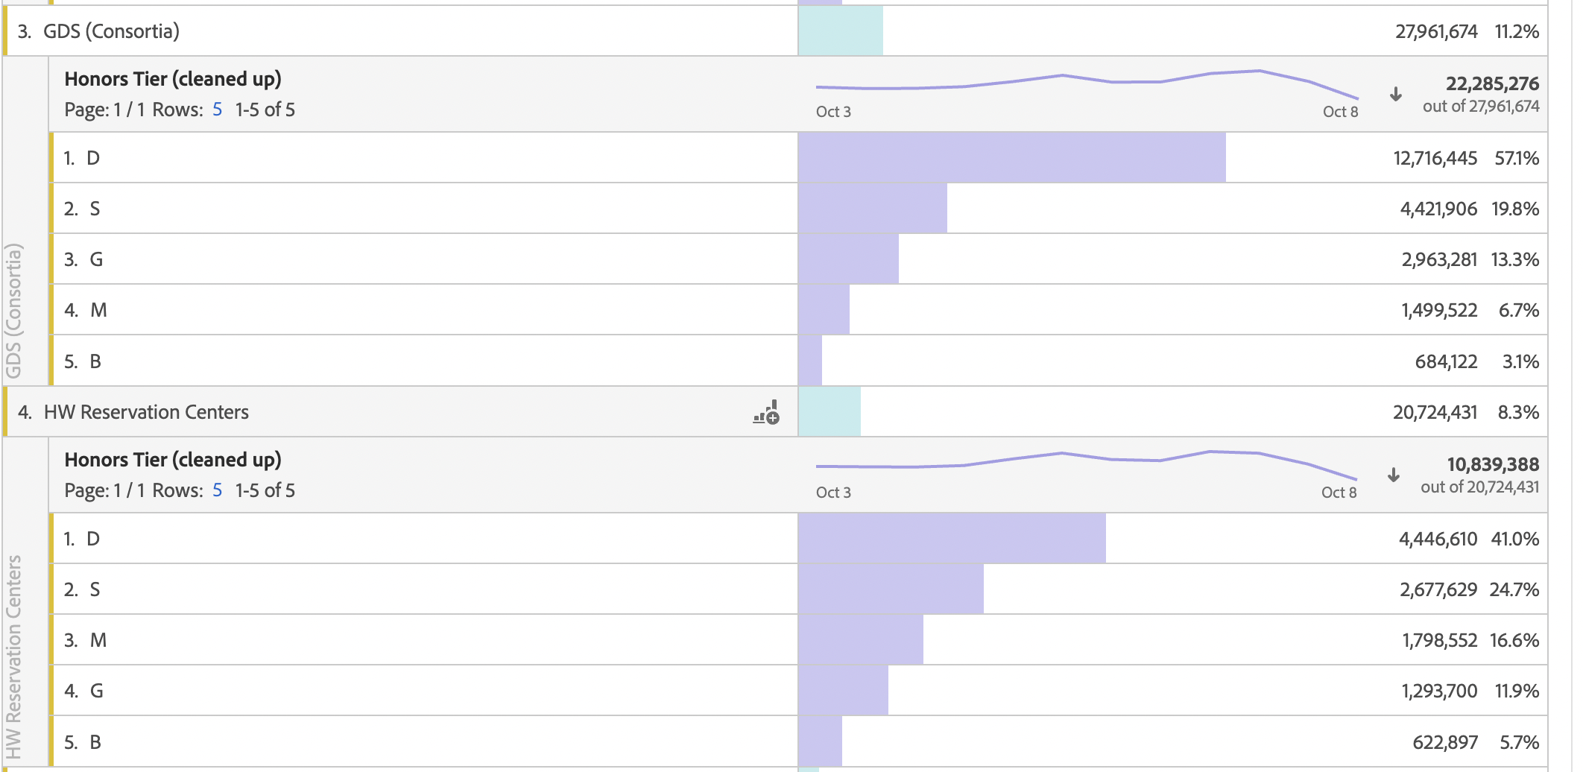

Slide 12
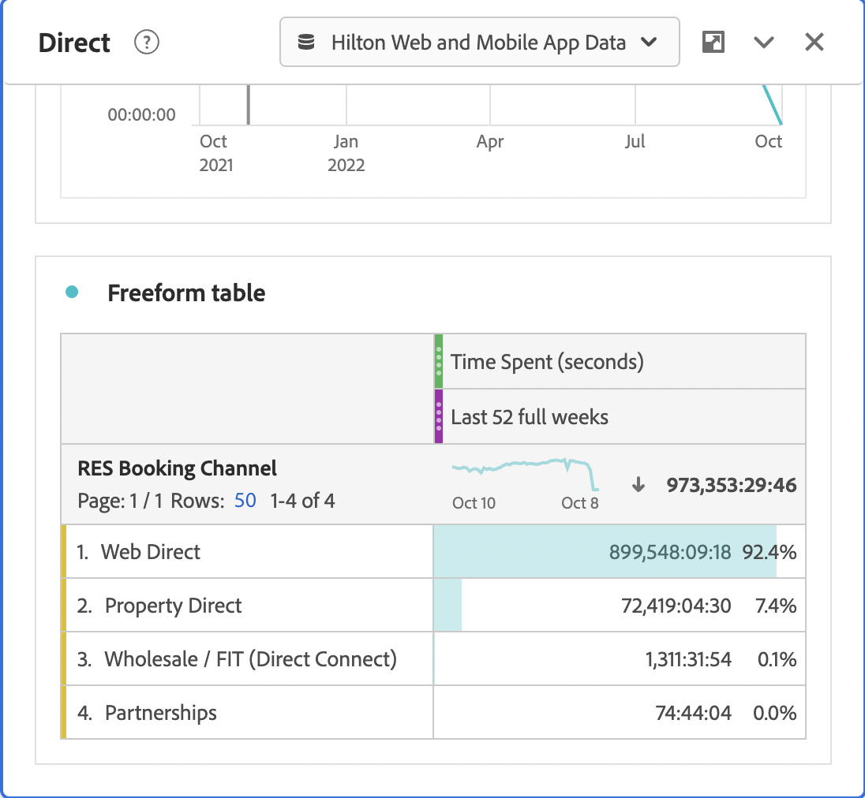
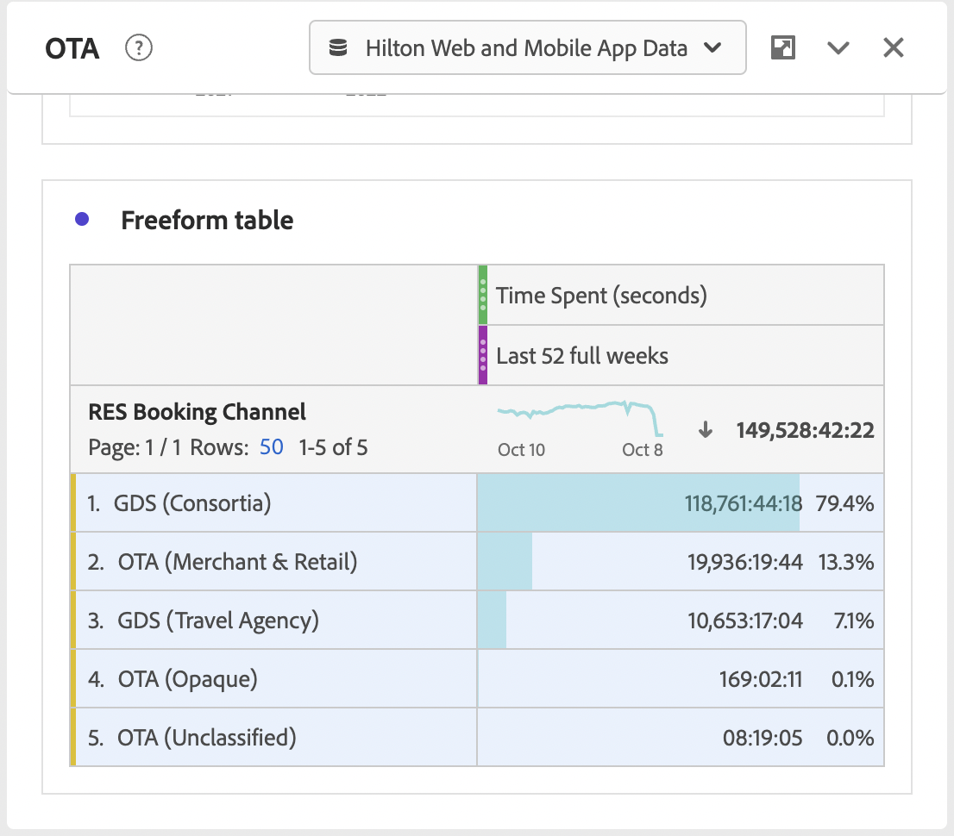
This could also be seen when we compare the time spent by users on OTA vs Direct. It is observed that the direct segment (website) attributes to almost 93% share of the time spent on the web direct while for OTAs, it is the GDS (consortia) whose share is around 79%.
Therefore, we can confidently say that Hilton is providing a different customer experience over the browser.

Slide 13
What is driving this trend?

Slide 14
DIRECT BOOKING vs OTA (OTHER TRAVEL AGENTS)
2
Synchronization issues:
Customers face issues when they book an unavailable room on OTA websites due to
synchronization issues
Different Cancellation policies:
Most of the times, OTAs and Direct company websites have different cancellation policies.
This might even affect the credibility of the brand and hence it is preferred to book via the company directly, rather than OTAs
Inability to know more about different products of Hilton:
Since OTAs host the products of many brands, the customers do not get the opportunity to explore all the products and promotional offers of Hilton, and might lead to an average customer experience

Slide 15
RISE OF OTAs:
2
The benefits of direct booking are many. But the power and influence of OTAs cannot be ignored. It is significant to create the perfect balance between OTAs and direct bookings to keep a regular flow of customers.
OTAs provide a lot of advantages to hotels, and the ‘Billboard Effect’ is one of them. People are more likely to search for your hotel and visit your website when they see you on an OTA.
Also, OTAs want to gain higher revenue. So, they provide extensive marketing to hotels, helping them reach a broader audience, and generate more bookings.
One of the major reasons people turn to OTAs is because they get to see and compare a lot of hotels. Also, the process of booking is really fast and seamless.
The very crucial aspect of OTAs in today’s time are the ratings and reviews that are given by other consumers who have had the experience of living in a specific hotel. This makes it even more reliable than hotel websites.

Slide 16
How to strike a balance?

Slide 17
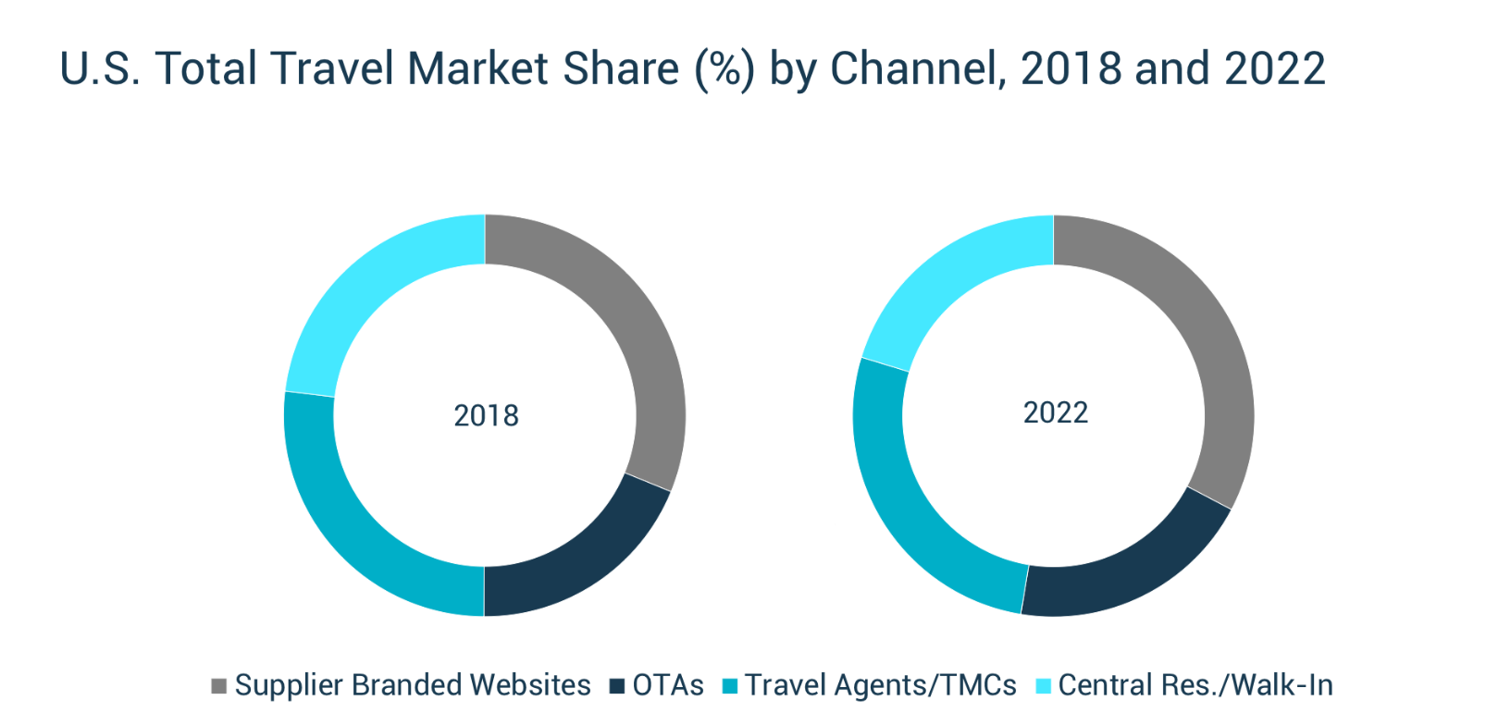
The rise of OTAs in the last three to four years has been significant, which gives us a lot of opportunities to capitalize on. There are a lot of learnings and data available, which could be applied to our experiences and enhance the web direct segment.
Source: https://application-assets.s3.amazonaws.com/pcwi/production/email/research/PhocuswrightChart-USTotalTravelMarketShareByChannel.png

Slide 18
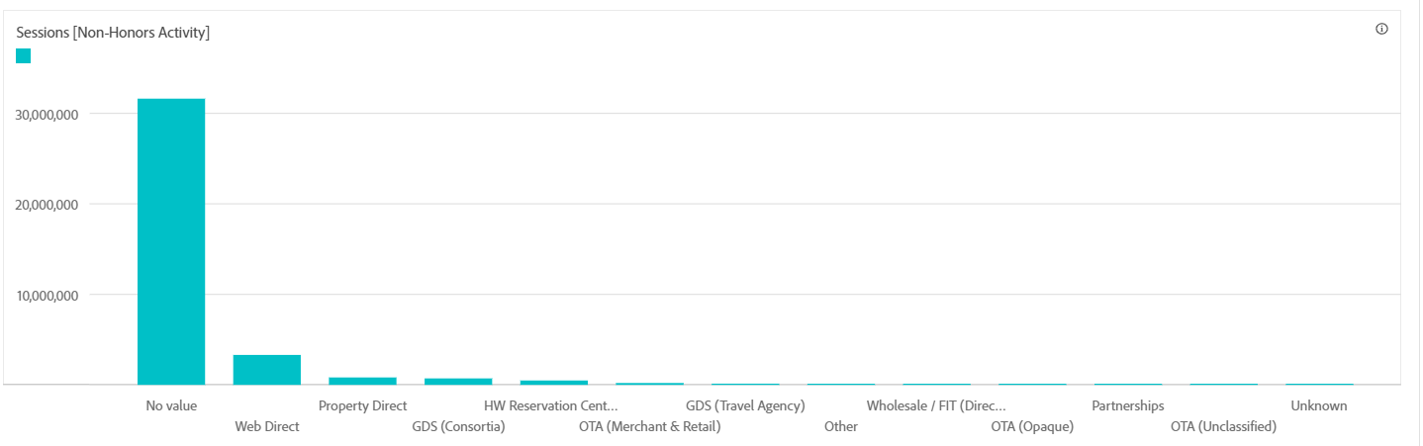
OPPORTUNITIES
3
1)
Enhance Direct Web Bookings

Slide 19
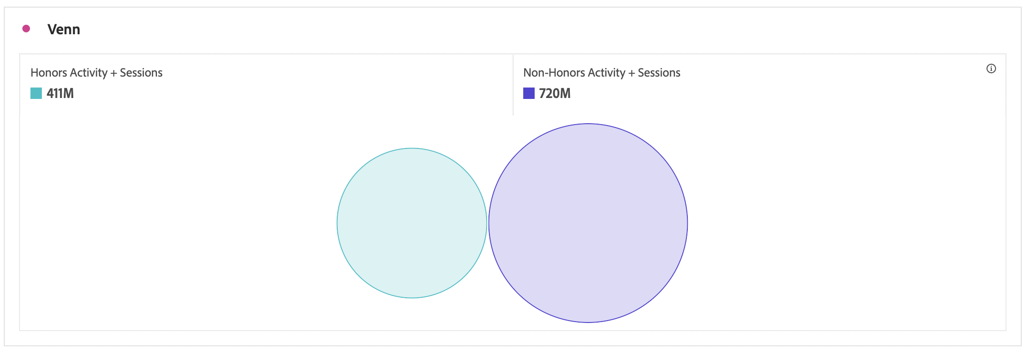
Traffic split for Honors and Non-Honors users:

Slide 20
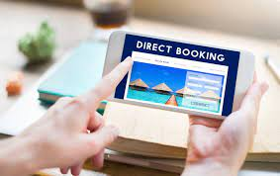
Most of the non-honors customers book with Hilton directly through Web Direct
Optimize the opportunity to attract more non-honors customers to Web Direct, since a large chunk of users belongs to this segment.
Try to optimize the software system to track ‘No Value’, which leads to the loss of insights and meaningful data

Slide 21
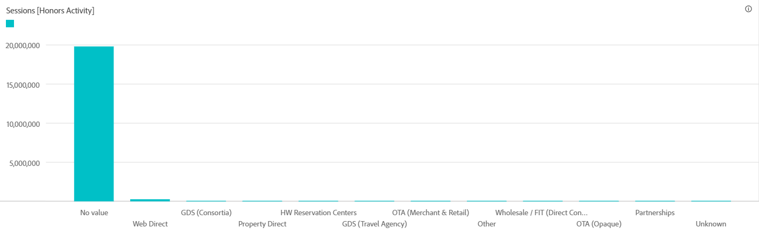
2)
Capitalize on GDS Consortia

Slide 22

The second most effective platform that attracts Honors tier members is GDS Consortia.
Despite being an OTA, GDS Consortia has been attracting huge chunks of honor tier customers.
Any strategy to form a synergy with GDS Consortia to collaborate with Hilton Website would attract more customers to Hilton website

Slide 23
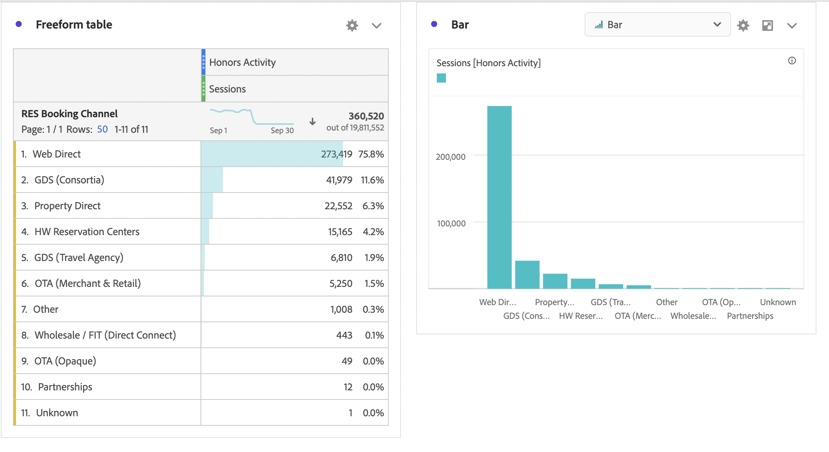
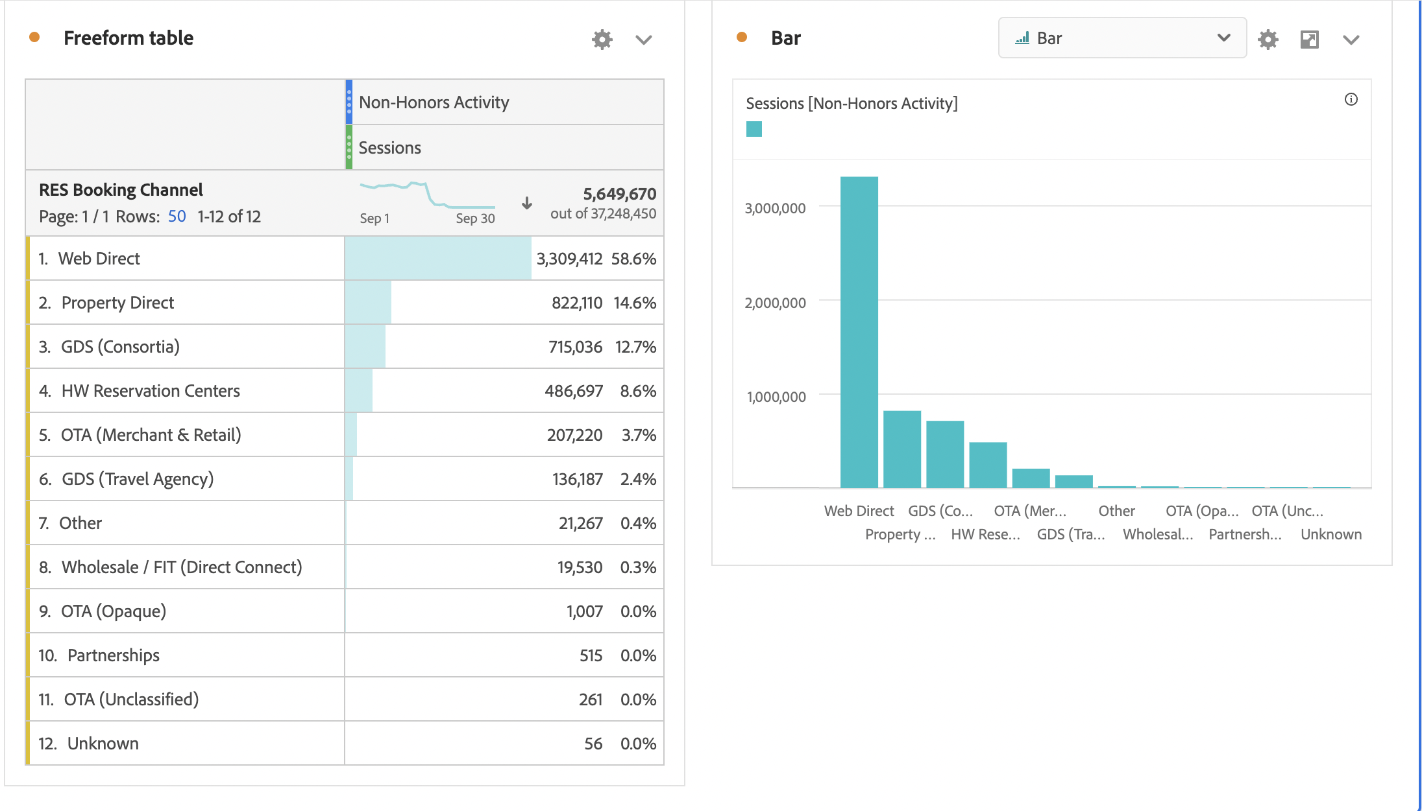
The difference between honors and non-honors activity might be one of the useful insights to look at.
Most of the sessions from both honors and non-honors tiers happen on Web Direct, which is good news for Hilton. But second, the highest sessions that are comprising almost 12% of the honors tier are going towards an OTA (GDS Consortia). This can be concerning as non-honors people are still coming to Property Direct but there also, GDS seems to attract a lot of traffic.
This can be because a lot of corporate bookings happen through Consortia. Hilton can introduce new programs where it can target bulk corporate booking accounts.
Honors Activity
Non-Honors Activity

Slide 24
Learnings and Observations:
1. Email Marketing:
One very interesting observation was that the email promotions have worked really well for Hilton since they are the second best on both OTAs and Direct avenues to bring in existing users on the platform. These might be because of:
Effective Promotional Campaigns
Periodic reminders to users to avail/redeem their points.
Targeting a specific audience who respond really well to these campaigns.
Therefore, the key learning could be here to deep dive and understand what exactly is Hilton doing differently using emails, since not many organizations are able to leverage email as an effective marketing avenue to bring people to their platform.

Slide 25
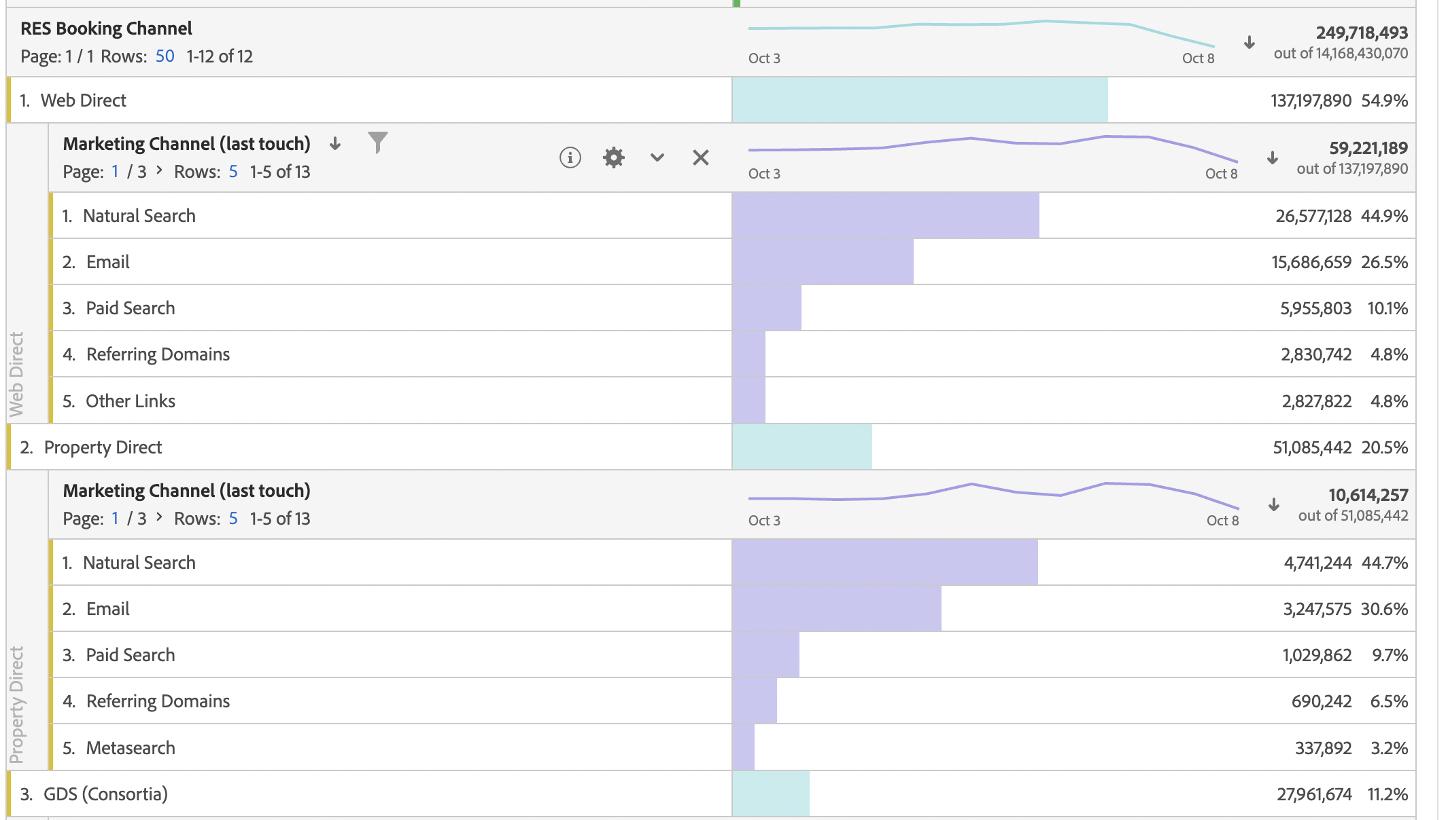

Slide 26
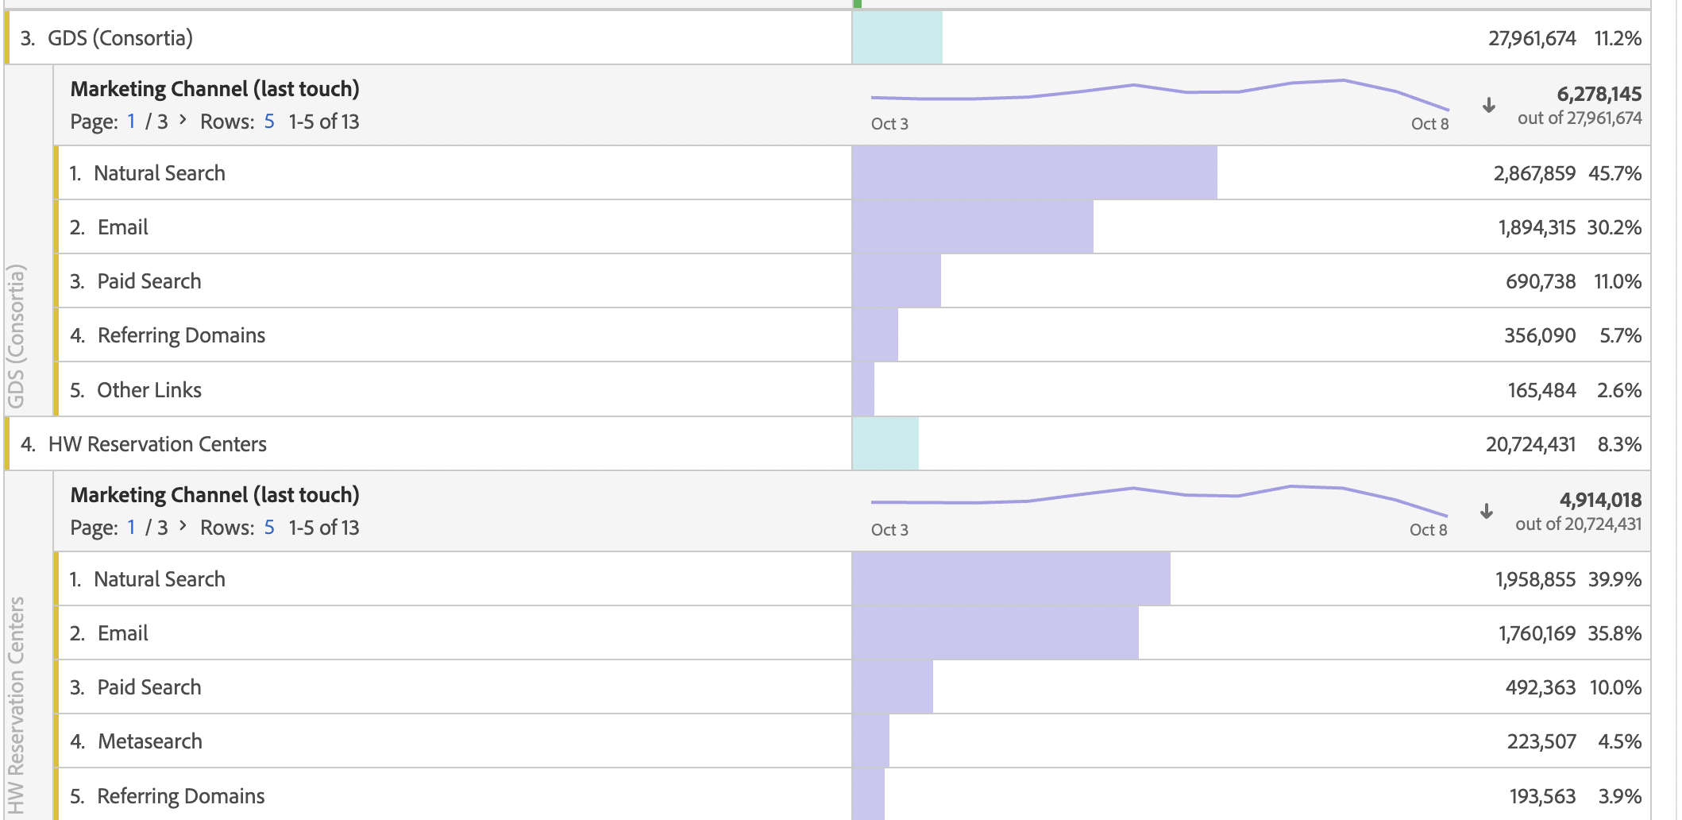

Slide 27
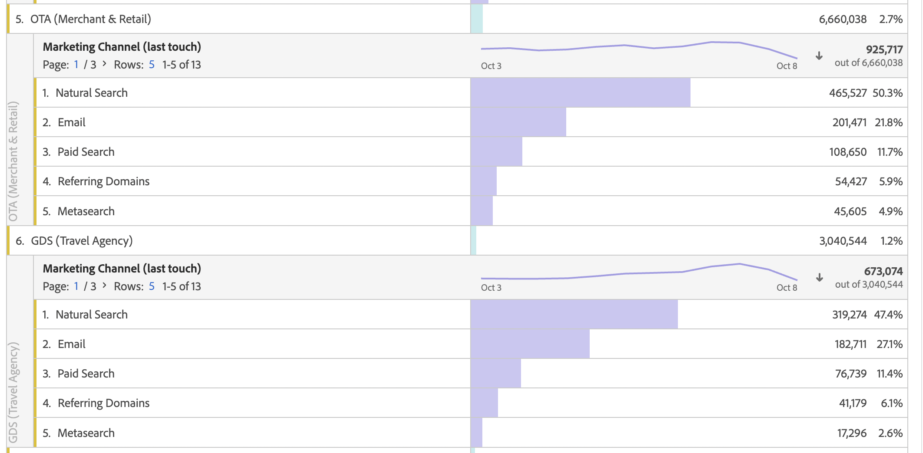

Slide 28
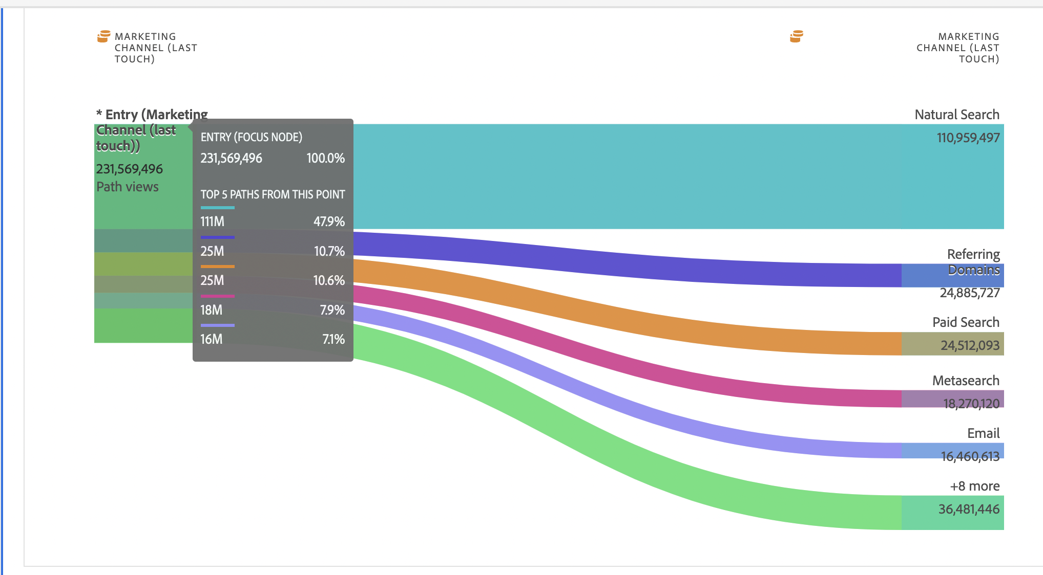
New Users are majorly drawn from Natural Search and Referring Domains, which indicates that their referral program can onboard new customers.

Slide 29
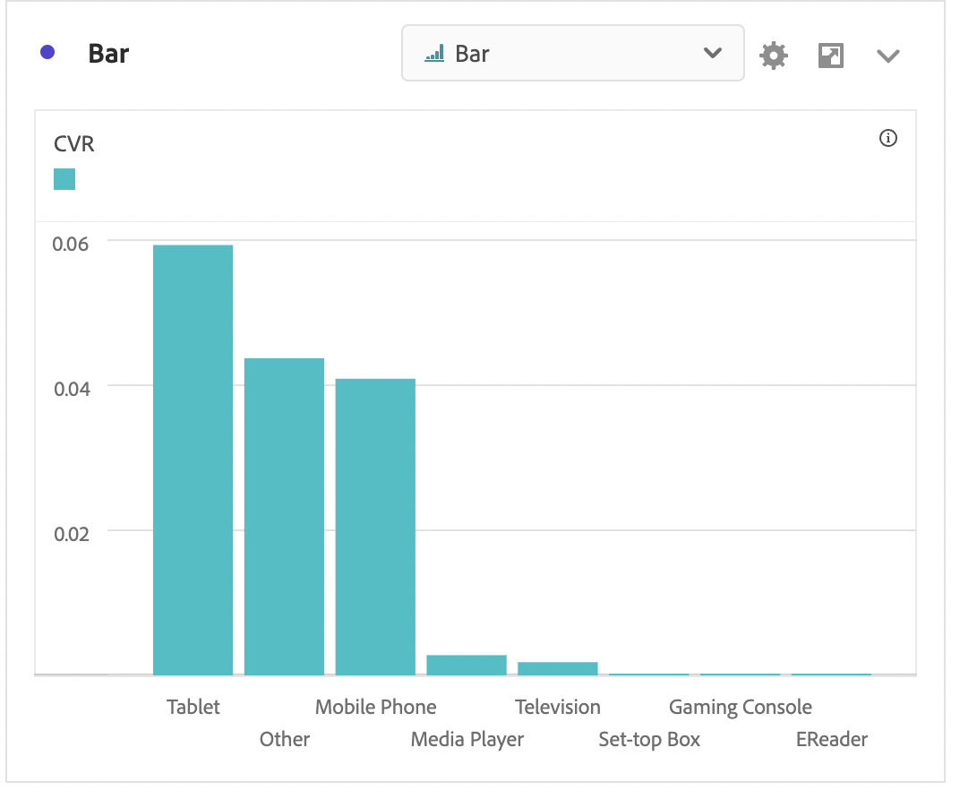
2. Conversion Rates:
Another surprising fact that conversion rates (No of Bookings/Total Sessions) are higher than any other device. However, the traffic volume might be less on Tablets, but while considering percentages, it is still higher than any other device.
This could be a learning within the organization for product teams which could be shared to learn and understand what could be applied to different devices.

Slide 30
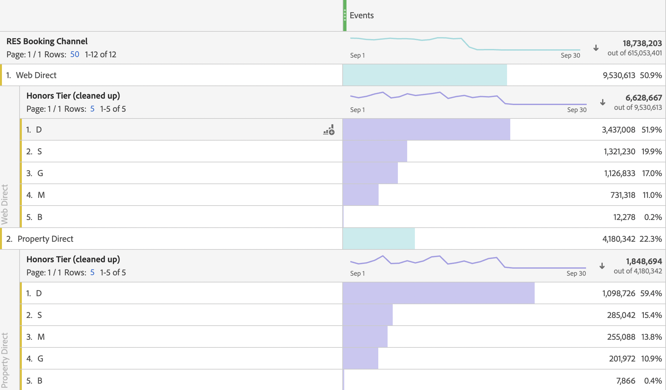
2. Honor Tier Gap :
One of the important factors to consider here is how the members from the honor tier respond to these two different kind of channels, i.e., Direct and OTA.
It’s not surprising to see that the elite members from the Honor Tier (Diamond) are the largest number of people to visit the Direct websites.

Slide 31
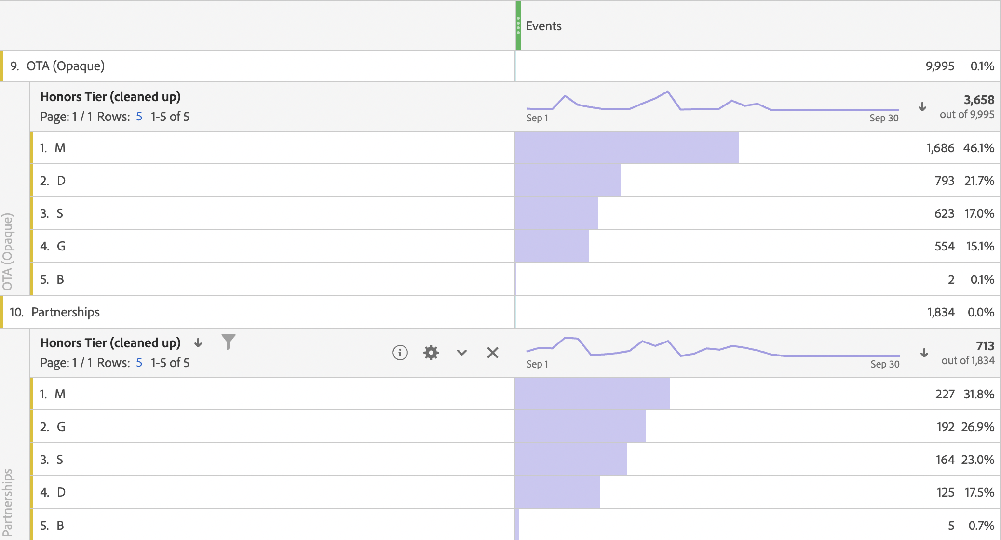
But when see the OTAs, it seems like a lot of members from not so premium honor tier tend to go to OTAs for their bookings.
This can be one of the concerns for Hilton as a company. The firm can equally attract its members through email marketing, discounts, and coupons so that people from the whole spectrum of honor tiers are pushed to use Hilton’s app/website.

Slide 32
THANK YOU!

